Slide 1
Benefits of working out on physiology

Slide 2
1.Shape good body
2.Prevent disease
3.Delay aging
4.Enhance
cardiopulmonary function

Slide 3
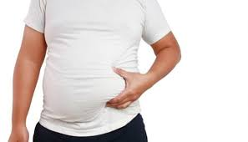
Good shape
A lot of people are overweight
in Taiwan

Slide 4

Good shape
Good looking

Slide 5
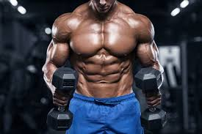
Good shape
Strong

Slide 6

Prevent disease
After training, it will become stronger.

Slide 7

Prevent disease
Kill bacteria and
virus

Slide 8

Delay aging
Enhance
muscle
content

Slide 9
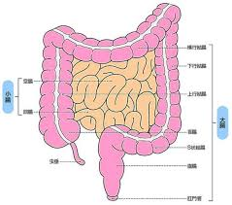
Delay aging
Make the digestive system
more powerful

Slide 10

Enhance cardiopulmonary function
Make the muscle of heart become stronger

Slide 11
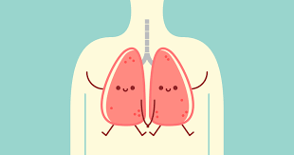
Enhance cardiopulmonary function
Make the ability of transport oxygen become better

